Slide 1
INTRODUCTION
To deploy (from the French deployer) is "to spread out or arrange strategically." Long used in the context of military strategy, it has now gained currency in information technology. In its IT context, deployment encompasses all the processes involved in getting new software or hardware up and running properly in its environment, including installation, configuration, running, testing, and making necessary changes. The word implementation is sometimes used to mean the same thing.

Slide 2
This project is Android based application which is deployed on cloud. It only works on Android devices. It comes under the category of games This app is committed to providing fun and exciting digital entertainment. This was specially designed for small children and focuses on learning little things through pictures. It gives all the information regarding pet dogs and cats. Children get the basic knowledge via colourful diagrammatic picturization. This is the Best looking free paid game for any android device . It includes sharp stunning graphics and animation. Its not an only online game and device does not need to be connected to internet. It hands down the best virtual pet game on the market, with more content than any other pet game.

Slide 3
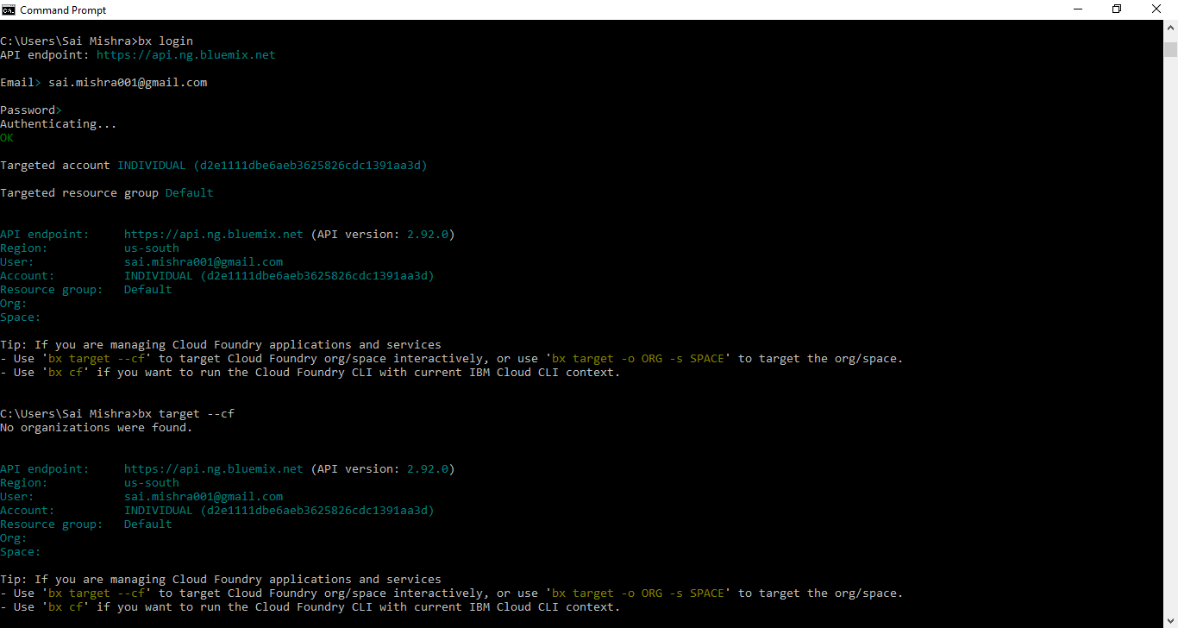
DEPLOYMENT ON IBM CLOUD

Slide 4
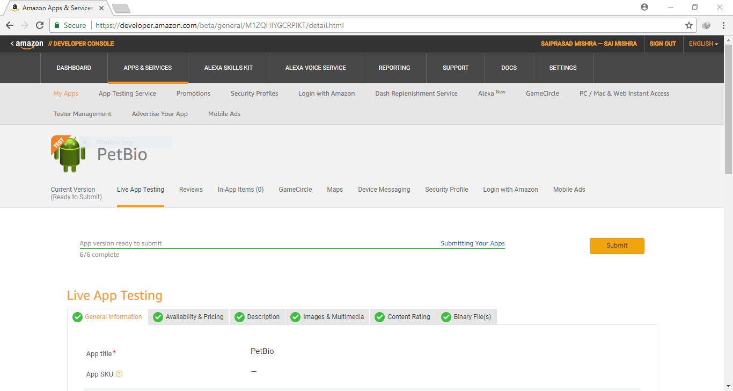

Slide 5
ANDROID APPLICATION UPLOAD ON AMAZON APP STORE

Slide 6
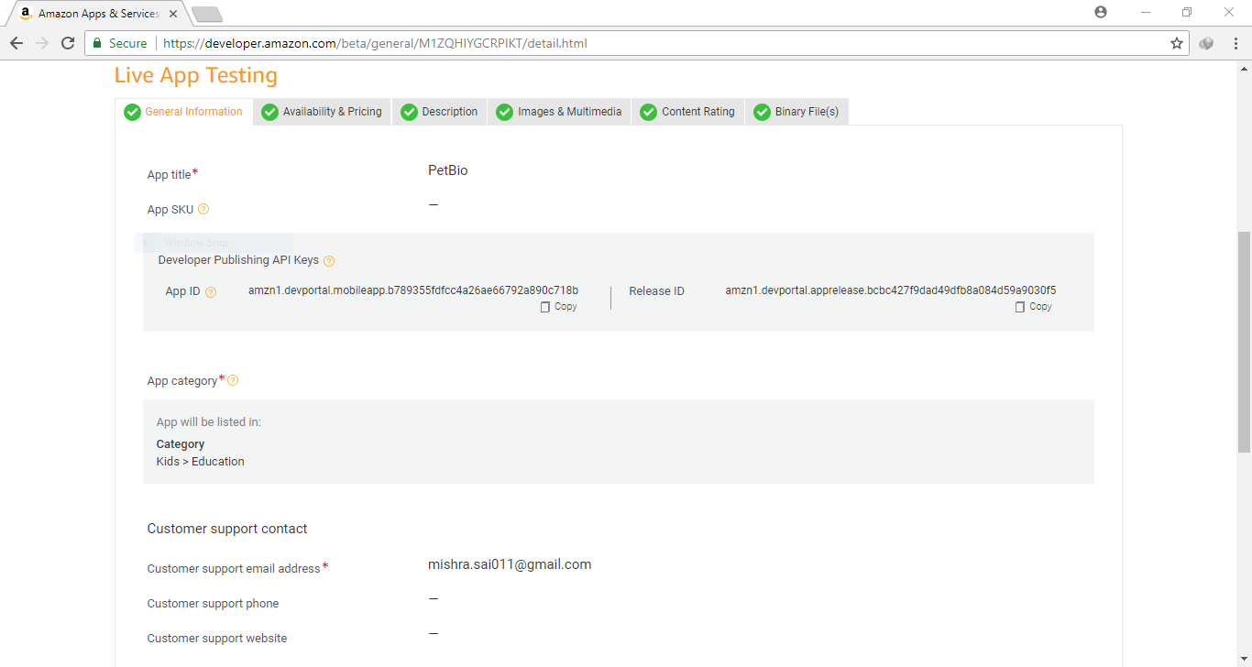

Slide 7
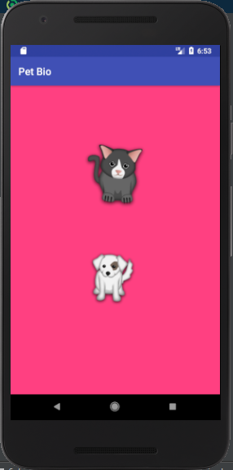
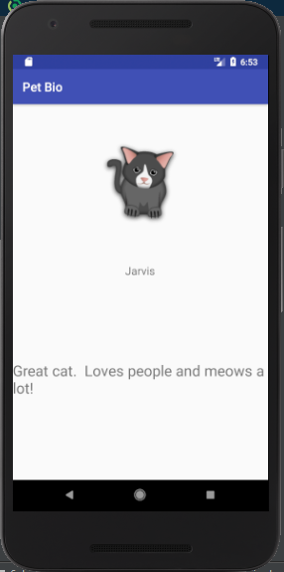
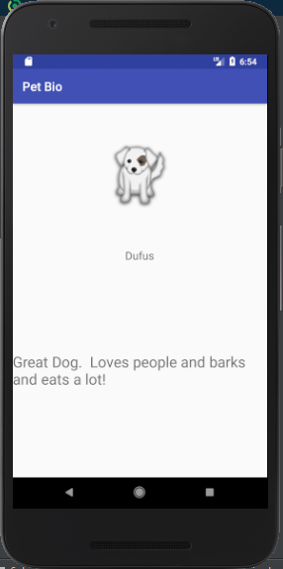
OUTPUT

